Slide 1
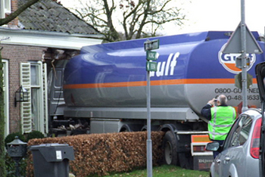
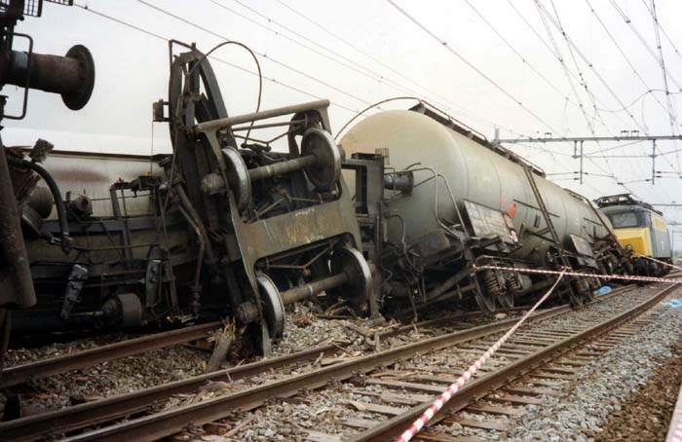
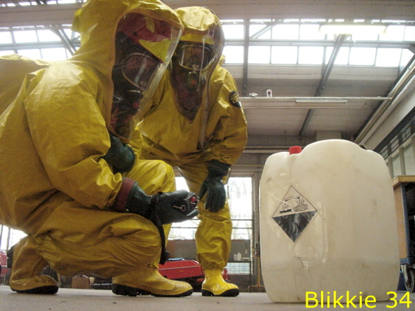
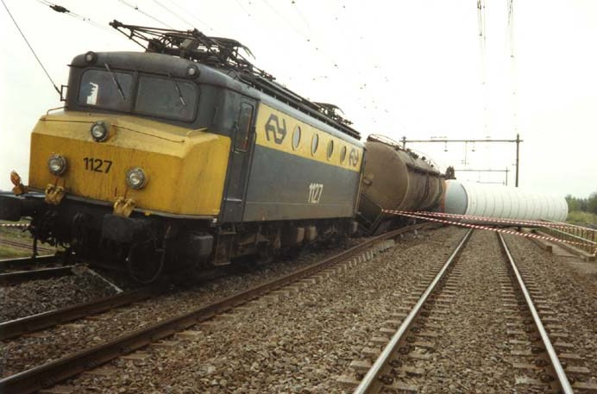

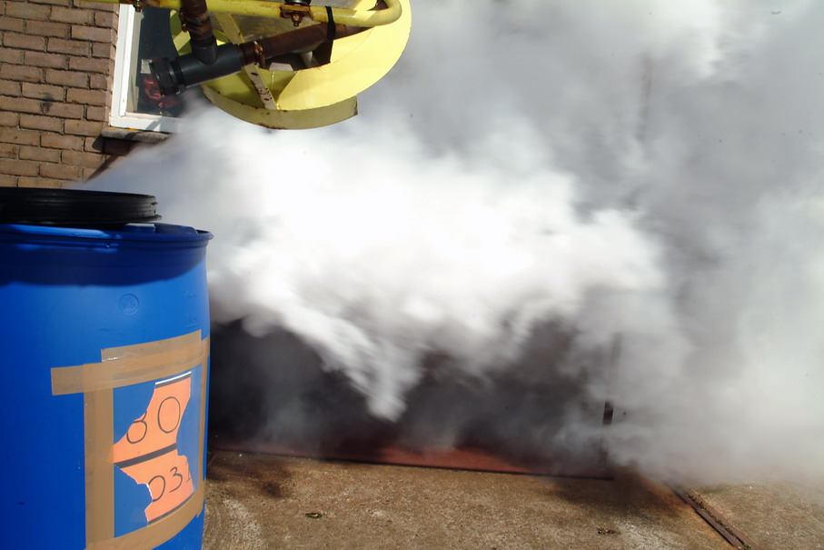
Dangerous goods

Slide 2
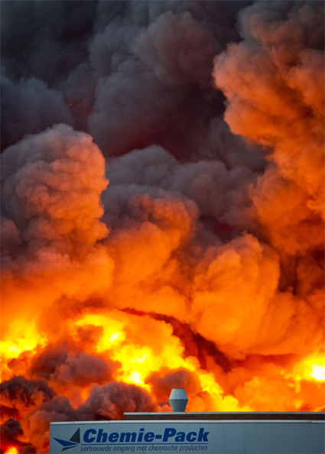
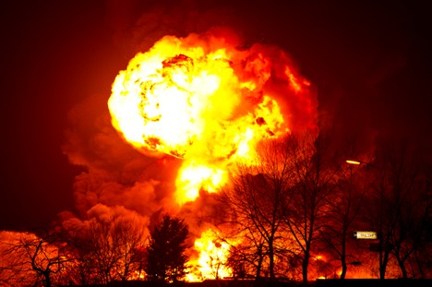
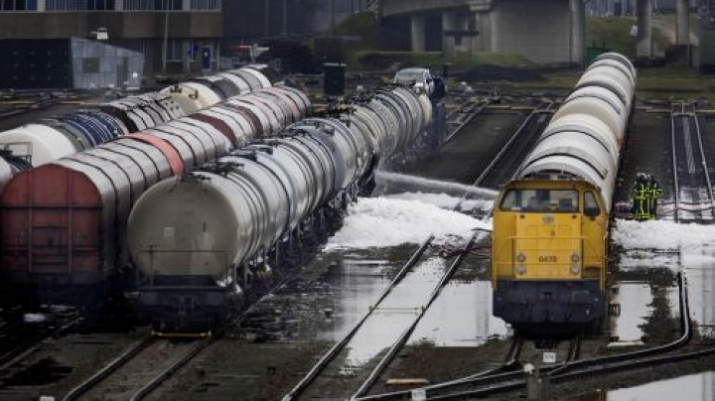
2011 started well !!
Accidents at Moerdijk Chemical parc and Kijfhoek railway shuntyard

Slide 3
Dangerous goods
Dangerous goods are solids, liquids or gases, that can harm people, other living organisms, property or the environment.

Slide 4
Dangerous goods / transport
ADR Accord européen relatif au transport international des marchandises Dangereuses par Route
ADN Accord européen relatif au transport international des marchandises Dangereuses par voies de Navigation intérieures.
RID Règlement concernant le transport international ferroviaire des marchandises dangereuses
IMDG International Maritime Dangerous Goods
IATA DG IATA Dangerous Goods (Airtransport)

Slide 5
Dangerous goods / storage
Due to the local activities, every country
has its own rules/laws:
For Holland:
Formerly: hinderwetvergunning
Nowadays: WM = Wet Milieubeheer

Slide 6
Dangerous goods / working with ..
Due to the local activities, every country has its own rules/laws:
For Holland:
WMS Wet Milieugevaarlijke stoffen
(Identify dangerous goods)
ARBO Arbeidsomstandighedenwet
(chance to get into contact, duty for care)

Slide 7
Birth of the recommendations
This treatment has been made in the EC of the UN at September 30th 1957.
It started at 29th of January 1968.
39 countries are members
The name of the treatment is: "Recommendations on the Transport of Dangerous Goods",
ADR = attachment of the treatment
Once per two year this regulation will be updated by a commision;
The new name will be ADR 2001, ADR 2003, ADR 2005...
In Holland the ADR is a part of the law WMS = Wet Milieugevaarlijke stoffen.

Slide 8

Division tunnels-regime
Category I: forbidden for transport of combustible or poisonous goods.
Category II: forbidden for all different kind of dangerous goods.

Slide 9

Class- 1- explosives
1.1 Explosives with a mass explosion hazard
Ex: TNT, dynamite, niutroglycerine .
1.2 Explosives with a severe projection hazard.
1.3 Explosives with a fire, blast or projection hazard but not a mass explosion hazard.
1.4 Minor fire or projection hazard (includes ammunition and most consumer fireworks).
1.5 An insensitive substance with a mass explosion hazard (explosion similar to 1.1)
1.6 Extremely insensitive articles.

Slide 10

Class 2- gases
Gases which are compressed, liquefied or dissolved under pressure . Some gases have subsidiary risk classes; poisonous or corrosive.
2.1 Flammable Gas: Gases which ignite on contact with an ignition source, such as acetylene and hydrogen
2.2 Non-Flammable Gases: Gases which are neither flammable nor poisonous. Includes the cryogenic gases/liquids (temperatures of below -100°C) used for cryopreservation and rocket fuels, such as nitrogen and neon.
2.3 Poisonous Gases: Gases liable to cause death or serious injury to human health if inhaled; examples are fluorine, chlorine and hydrogen cyanide.

Slide 11

Class 3- flammable liquides
Flammable liquids included in Class 3 are included in one of the following packing groups:
Packing Group I: if they have an initial boiling point of 35°C or less at an absolute pressure of 101.3 kPa and any flash point, such as diethyl ether or carbon disulfide;
Packing Group II: if they have an initial boiling point greater than 35°C at an absolute pressure of 101.3 kPa and a flash point less than 23°C, such as gasoline (petrol) and acetone or
Packing Group III: if the criteria for inclusion in Packing Group I or II are not met, such as kerosene and diesel.

Slide 12
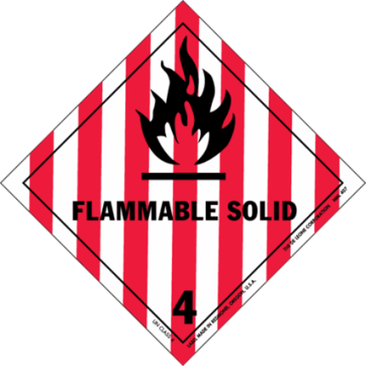
Class 4 – flammable solids
4.1 Flammable Solids: Solid substances that are easily ignited and readily combustible (nitrocellulose, magnesium, safety or strike-anywhere matches).
4.2 Spontaneously Combustible: Solid substances that ignite spontaneously (aluminium alkyls, white phosphorus ).
4.3 Dangerous when Wet: Solid substances that emit a flammable gas when wet or react violently with water (sodium, calcium, potassium, calcium carbide).

Slide 13
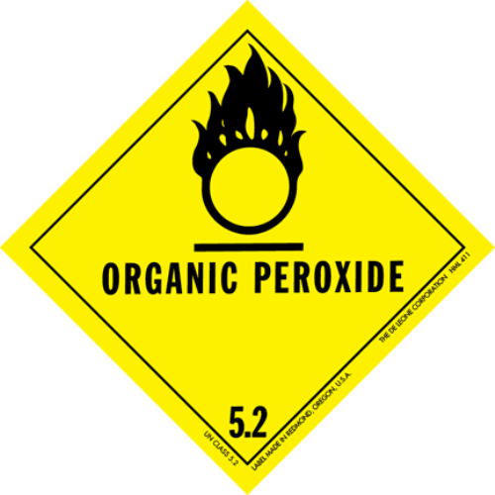
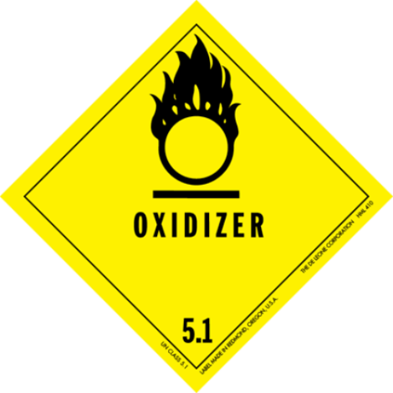
Class 5 – oxididing agents and organic peroxides
5.1 Oxidizing agents other than organic peroxides (calcium hypochlorite, ammonium nitrate, hydrogen peroxide, potassium permanganate)
5.2 Organic peroxides, either in liquid or solid form (benzoyl peroxides, cumene hydroperoxide).

Slide 14

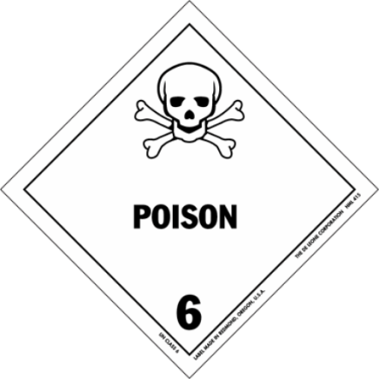
Class 6 – toxic and infectious substances
6.1a Toxic substances which are liable to cause death or serious injury to human health if inhaled, swallowed or by skin absorption (potassium cyanide, mercuric chloride).
6.1b Toxic substances which are harmful to human health (pesticides, methylene chloride).
6.2 Biohazardous substances; the World Health Organization (WHO) divides this class into two categories:
Category A: Infectious;
Category B: Samples (virus cultures, pathology specimens, used intravenous needles).

Slide 15
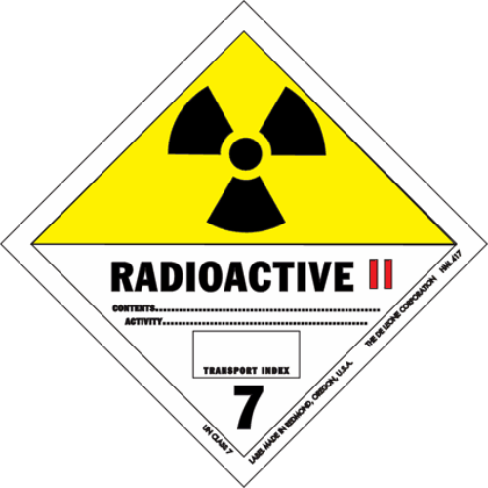
Class 7 – radioactive
Radioactive substances comprise substances
or a combination of substances which emit
ionizing radiation (uranium, plutonium).

Slide 16

Class 8 – corrosive substances
Corrosive substances are substances that can dissolve organic
tissue or severely corrode certain metals:
8.1 Acids: sulfuric acid, hydrochloric acid
8.2 Alkalis: potassi um hydroxide, sodium hydroxide

Slide 17

Class 9 Miscellaneous
Hazardous substances that do not fall into the
other categories.
(asbestos, air-bag inflators, self inflating life rafts, dry ice).

Slide 18
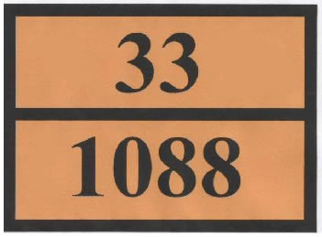
Explanation Kemler code
Emergency action code:
UN number:

Slide 19
Emergency action codes
2 gases
3 flammable liquids
4 flammable solids
5 oxididing and organic danger
6 toxic or infectious danger
7 radioactivity
8 corrosive
9 first figure: various dangers (incl. environmental danger)
9 last figure: danger for spontanious reactions
X dangerous reaction in combination with water
A double figure will emphasize the danger (e.g. 30= flammable liquids; 33 = easy flammable liquids).

Slide 20
UN-numbers (example)
UN 1201 | 3 | Fusel oil
UN 1202 | 3 | Gas oil or Diesel fuel or Heating oil, light
UN 1203 | 3 | Gasoline
UN 1204 | 3 | Nitroglycerin, solution in alcohol, with not more than 1 percent nitroglycerin
UN 1206 | 3 | Heptanes
UN 1207 | 3 | Hexaldehyde
UN 1208 | 3 | Hexanes
UN 1210 | 3 | Printing ink, flammable
UN 1212 | 3 | Isobutanol or Isobutyl alcohol
UN 1213 | 3 | Isobutyl acetate
UN 1214 | 3 | Isobutylamine
UN 1216 | 3 | Isooctenes
UN 1218 | 2 | Isoprene, inhibited
UN 1219 | 3 | Isopropanol or Isopropyl alcohol
UN 1220 | 3 | Isopropyl acetate

Slide 21
Special Emergency Action codes
22 Refrigerated gases
333 Spontaneous combusting fluids
44 Flammable solids at high temperature and in molten condition
606 Infectious material
99 heated material (various dangerous goods)

Slide 22
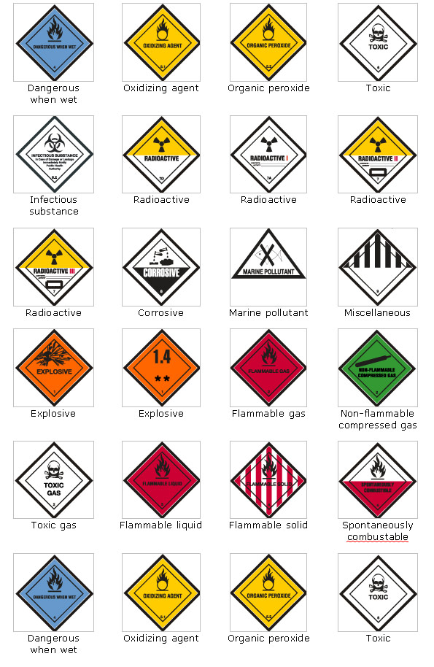
Second indication
Next to the Kemler code….
the TDG placard
Colors related to the danger:
Orange - explosive
Red - flammable fluid or gas
Green - non-flammable, compressed gas
White toxic or infectious goods
Blue - Dangerous when wet

Slide 23
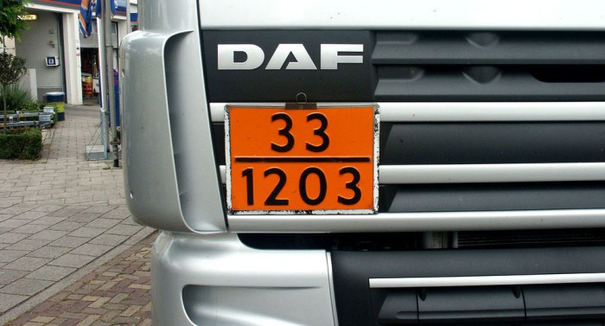
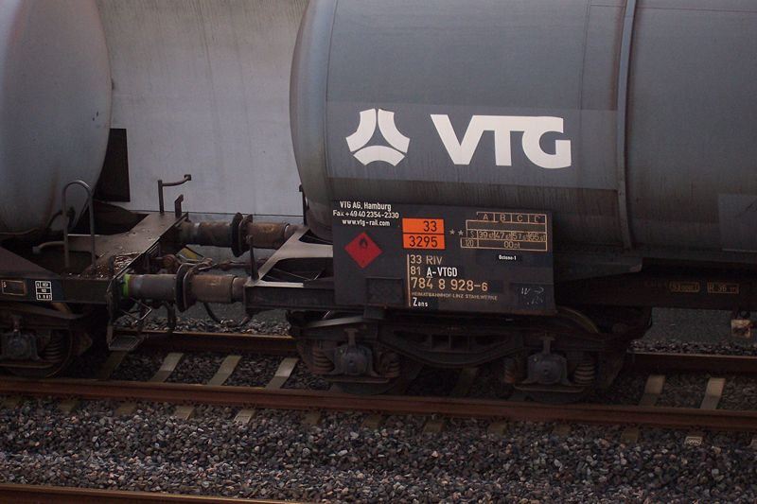
Kemlercode plus TDG placards

Slide 24
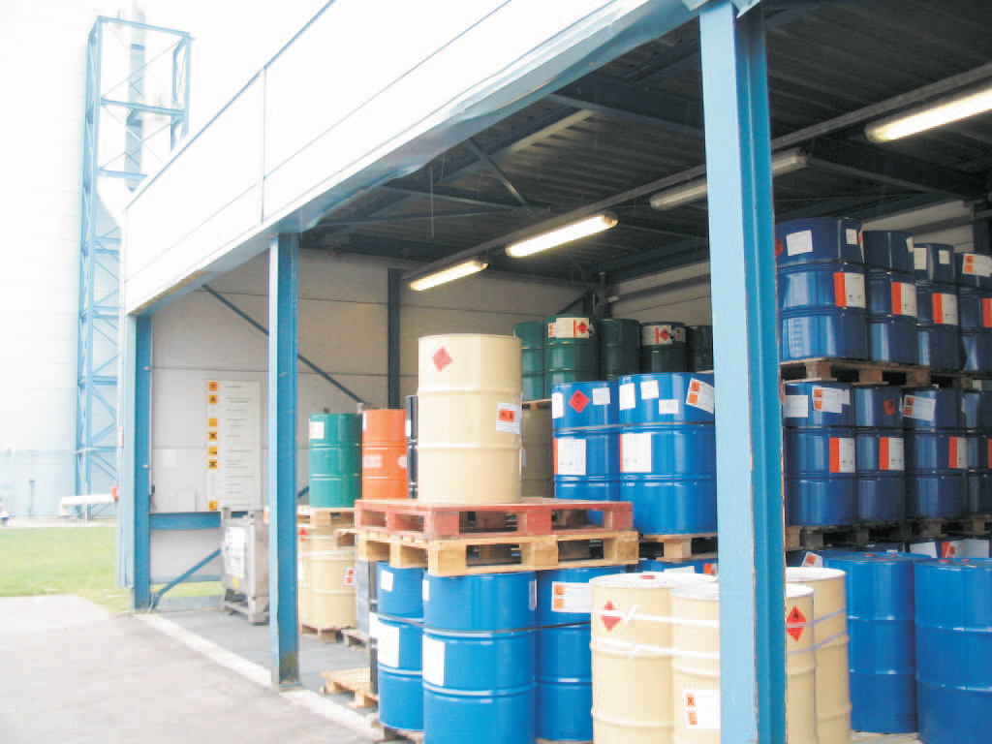
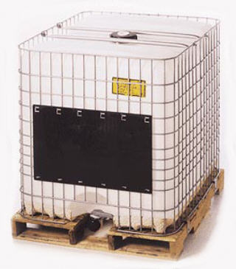
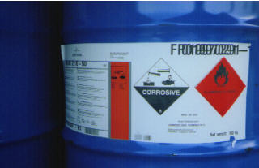
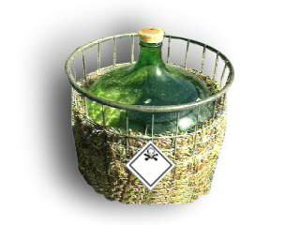
Package and storage
Avoid danger
Limit risks
Limit consequences of calamities.

Slide 25
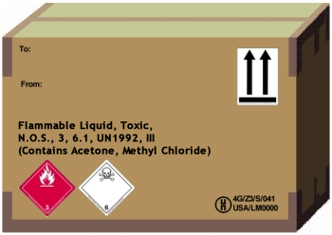
Packages
Package group I X-package (very strong) very dangerous goods
Package group II Y-package (less strong) dangerous goods
Package group III Z-package (least strong) less dangerous
N.O.S. (not otherwise specified)
Class 3 flammable liquid
6,1 Class 6 toxic
Un-code 1992 Flammable liquids, toxic, n.o.s.
Package III

Slide 26
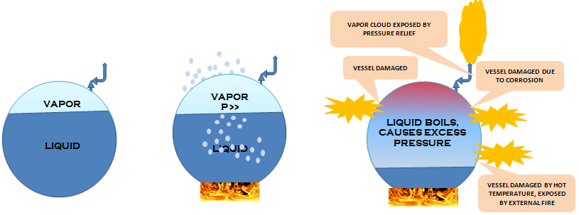
BLEVE Boiling Liquid Expanding Vapour Explosion (kokende vloeistof-gasexpansie-explosie).
A BLEVE typically starts with a container of liquid which is held above its normal, atmospheric-pressure boiling temperature.
Vapor cloud exposed by pressure relief
Container damaged
Container damaged due to corrosion
Container damaged by hot temperature, exposed by external fire

